Slide 1
P3
Tagging Guide

Slide 2
Common

Slide 3
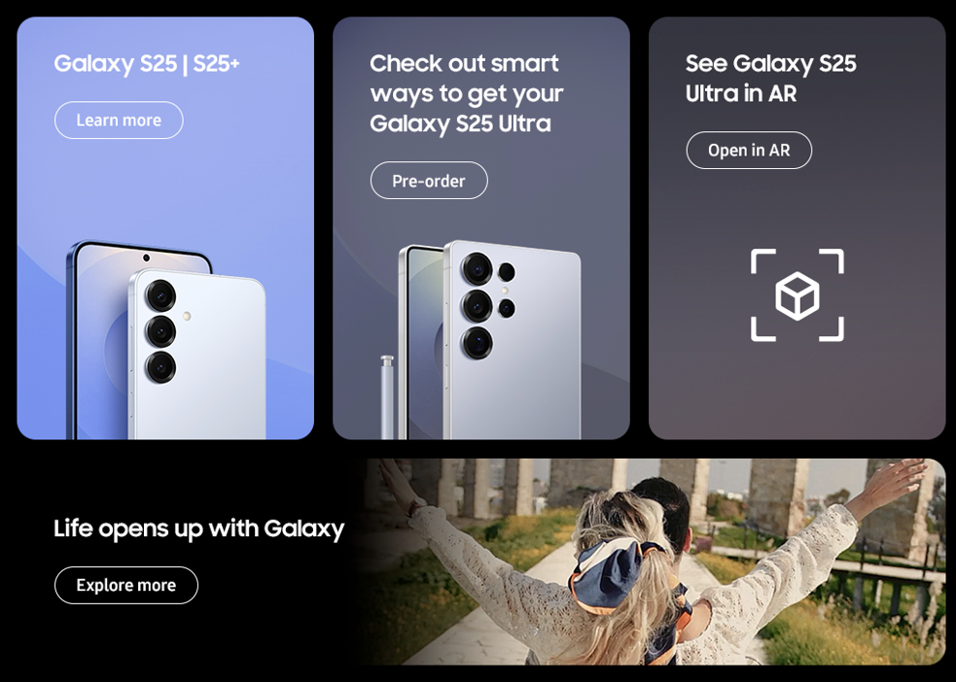
Common(Bottom Banner) - features
1
3
2
4
No. |  | Tagging Source
1 |  | Click to go Galaxy S25 MKT PD Features page
 | AA | data-omni-type="microsite_contentinter” data-omni="galaxy-s25-ultra:features:bottom^bnn:link-page:galaxy-s25"
 | GA | ga-ca="content click" ga-ac="feature" ga-la="galaxy-s25-ultra:features:bottom^bnn:link-page:galaxy-s25"
 |  | Pre-order
 | AA | data-omni-type="microsite_buyAction" data-omni="galaxy-s25-ultra:features:btm^banner:conv-pdt:pre-order|;SM-S938"
 | GA | ga-ca="buy cta" ga-ac="pre-order" ga-la="galaxy-s25-ultra:features:btm^banner:conv-pdt:pre-order"
 |  | Buy now
 | AA | data-omni-type="microsite_buyAction” data-omni="galaxy-s25-ultra:features:btm^banner:conv-pdt:buy-now|;SM-S938"
 | GA | ga-ca="buy cta" ga-ac="buy now" ga-la="galaxy-s25-ultra:features:btm^banner:conv-pdt:buy-now"
 |  | Reserve-now
 | AA | data-omni-type="microsite_buyAction" data-omni="galaxy-s25-ultra:features:btm^banner:conv-pdt:reserve-now|;SM-S938"
 | GA | ga-ca="buy cta" ga-ac="reserve now" ga-la="galaxy-s25-ultra:features:btm^banner:conv-pdt:reserve-now"
2 |  | Where to buy
 | AA | data-omni-type="microsite_buyAction" data-omni="galaxy-s25-ultra:features:btm^banner:conv-pdt:where-to-buy|;SM-S938"
 | GA | ga-ca="buy cta" ga-ac="where to buy" ga-la="galaxy-s25-ultra:features:btm^banner:conv-pdt:where-to-buy"
3 |  | Click to go Open in AR page
 | AA | data-omni-type="microsite_contentinter" data-omni="galaxy-s25-ultra:features:bottom^bnn:link-page:open-in-ar"
 | GA | ga-ac="feature" ga-la="galaxy-s25-ultra:features:bottom^bnn:link-page:open-in-ar"
4 |  | Click to go Why Galaxy page
 | AA | data-omni-type="microsite_contentinter" data-omni="galaxy-s25-ultra:features:bottom^bnn:link-page:why-galaxy"
 | GA | ga-ca="content click" ga-ac="feature" ga-la="galaxy-s25-ultra:features:bottom^bnn:link-page:why-galaxy"

Slide 4
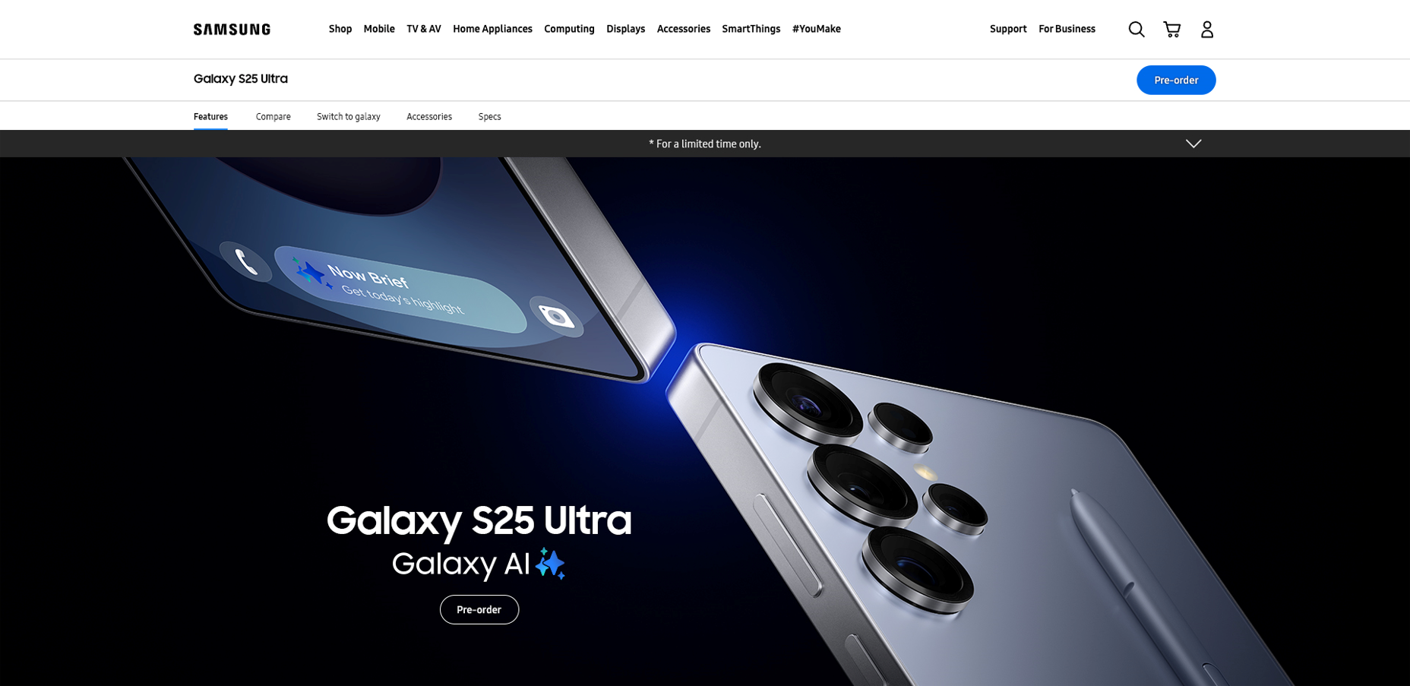
Features-KV
1
1 | 클릭 시, 오퍼 메시지 열기
2 | 클릭 시, 오퍼 메시지 닫기
3456 | 클릭 시 Galaxy S25 Ultra Buying 페이지로 이동 CTA TEXT : Pre-order / Buy now / Pre-reserve / Where to buy
2
3
No. |  | Tagging Source
1 |  | KV Drop down - Open
 | AA | data-omni-type="microsite_pcontentinter" data-omni="galaxy-s25-ultra:features:kv:acdn-open:offer"
 | GA | ga-ca="indication" ga-ac="accordion" ga-la="galaxy-s25-ultra:features:kv:acdn-open:offer"
2 |  | KV Drop down - Close
 | AA | data-omni-type="microsite_pcontentinter" data-omni="galaxy-s25-ultra:features:kv:acdn-close:offer"
 | GA | ga-ca="indication" ga-ac="accordion" ga-la="galaxy-s25-ultra:features:kv:acdn-close:offer"
3 |  | Pre-order
 | AA | data-omni-type="microsite_buyAction" data-omni="galaxy-s25-ultra:features:key-vis^img:conv-pdt:pre-order|;SM-S938"
 | GA | ga-ca="buy cta" ga-ac="pre-order-now" ga-la="galaxy-s25-ultra:features:key-vis^img:conv-pdt:pre-order"
4 |  | Buy now
 | AA | data-omni-type="microsite_buyAction" data-omni="galaxy-s25-ultra:features:key-vis^img:conv-pdt:buy-now|;SM-S938"
 | GA | ga-ca="buy cta" ga-ac="buy-now" ga-la="galaxy-s25-ultra:features:key-vis^img:conv-pdt:buy-now"
5 |  | Reserve now
 | AA | data-omni-type="microsite_buyAction" data-omni="galaxy-s25-ultra:features:key-vis^img:conv-pdt:reserve-now|;SM-S938"
 | GA | ga-ca="buy cta" ga-ac="reserve-now" ga-la="galaxy-s25-ultra:features:key-vis^img:conv-pdt:reserve-now"
6 |  | Where to buy
 | AA | data-omni-type="microsite_buyAction" data-omni="galaxy-s25-ultra:features:key-vis^img:conv-pdt:where-to-buy|;SM-S938"
 | GA | ga-ca="buy cta" ga-ac="where-to-buy" ga-la="galaxy-s25-ultra:features:key-vis^img:conv-pdt:where-to-buy"

Slide 5
EOD

